Slide 1

Trailer

Slide 2


We are #1
Project Hope

Slide 3
Our game
Why is it fun?
Why is it good for the campaign?
Why is it on mobile? (target audience)

Slide 4
Play the game

Slide 5

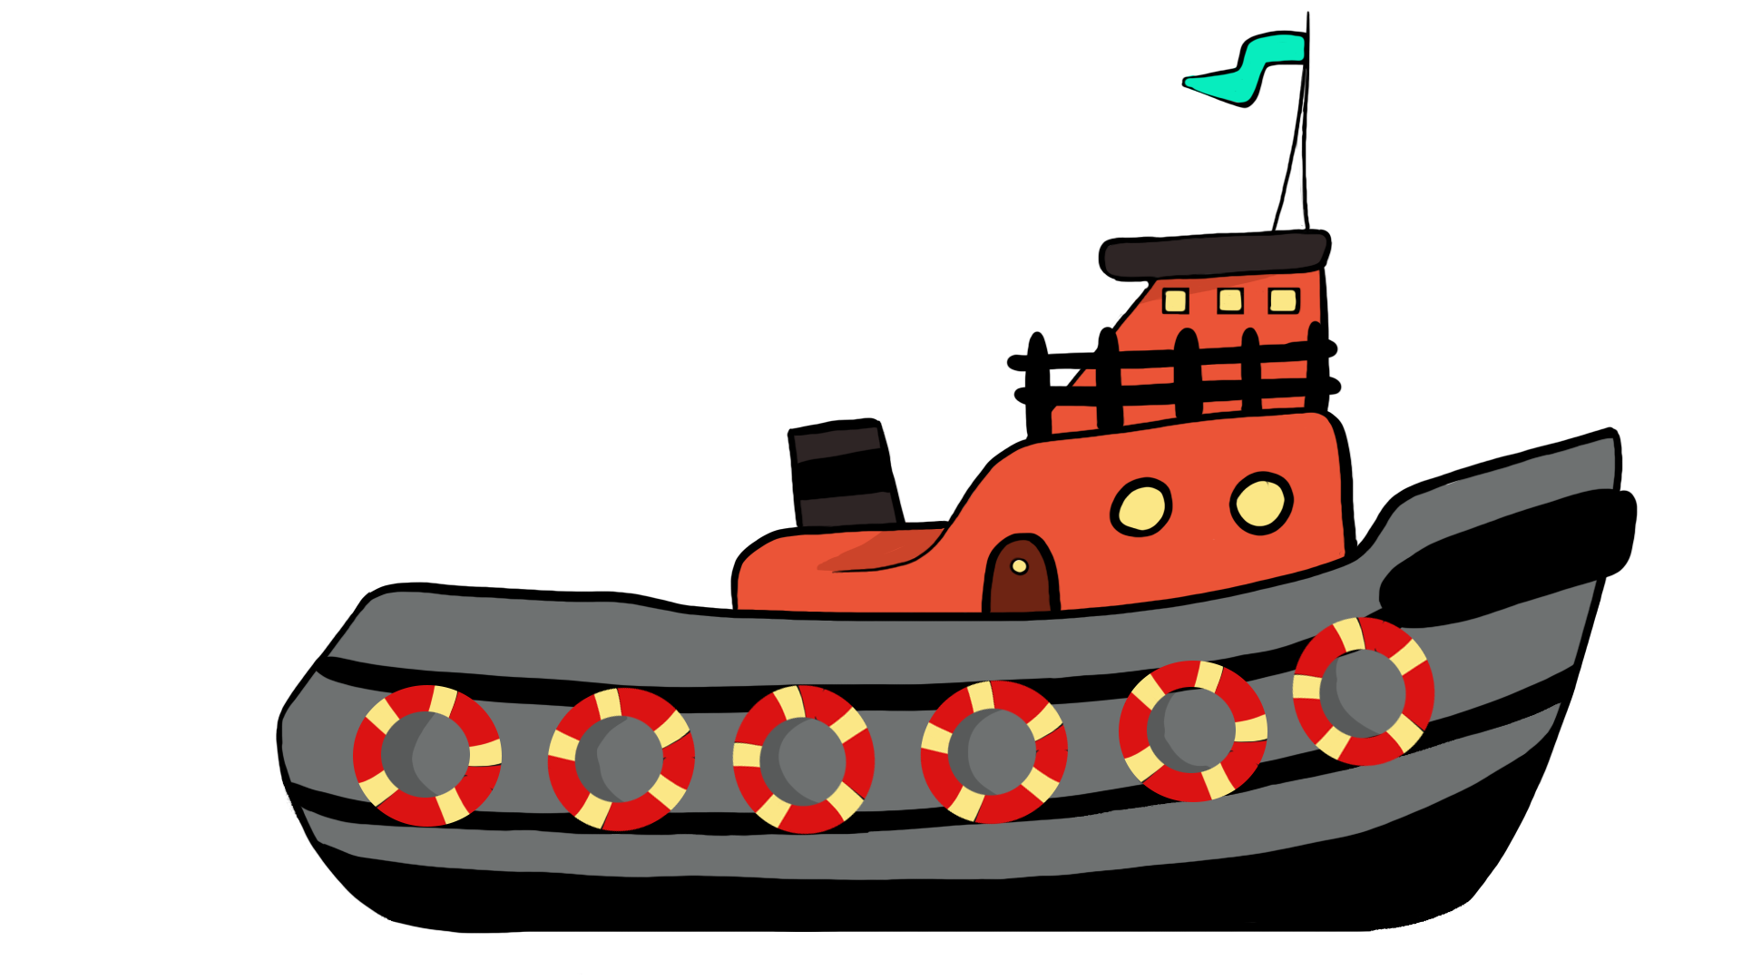
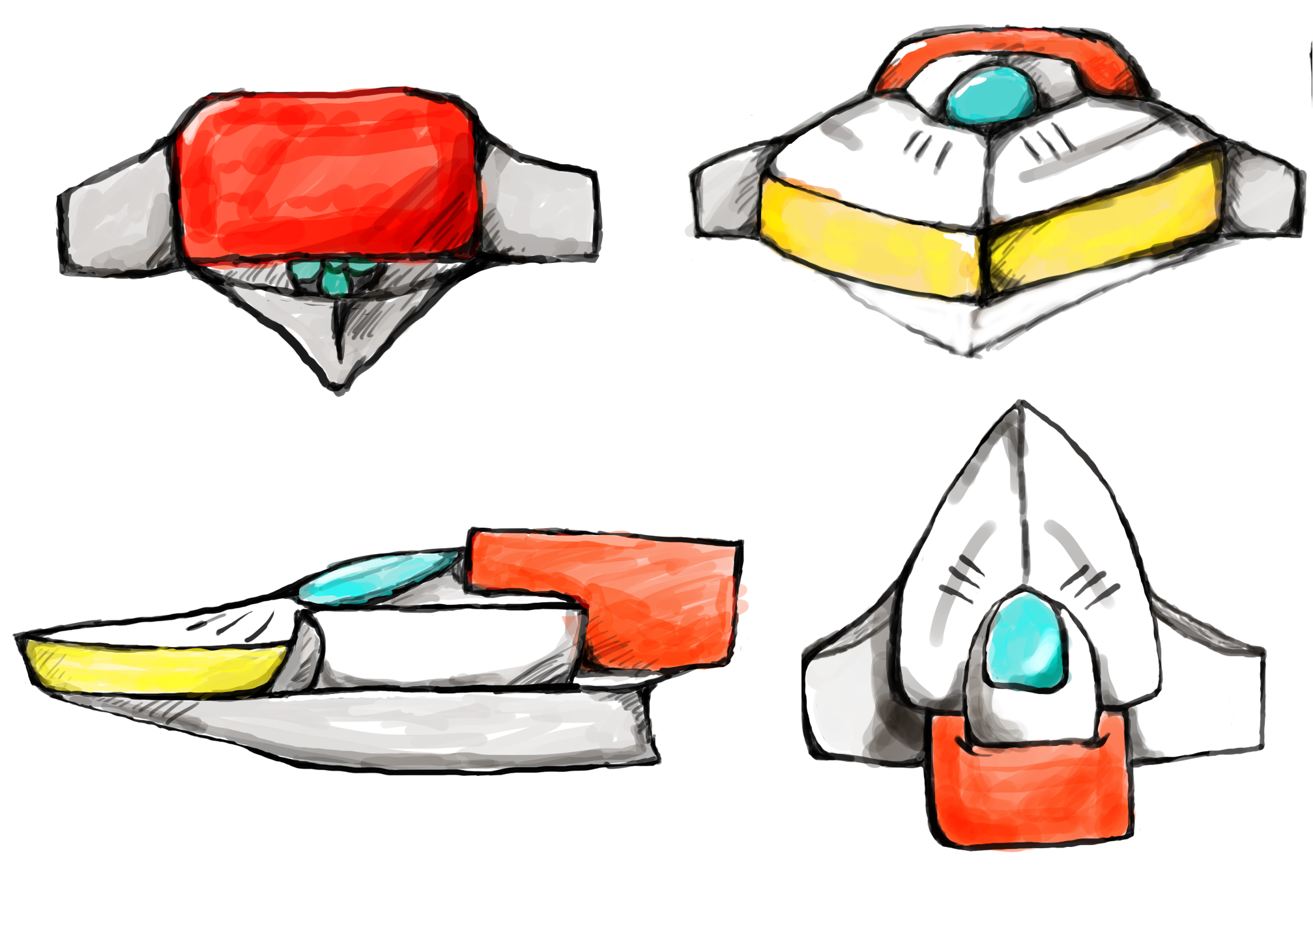
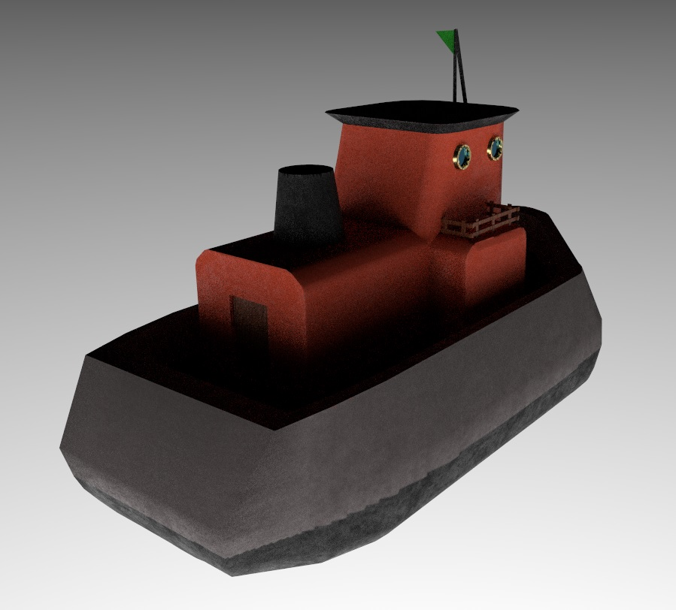
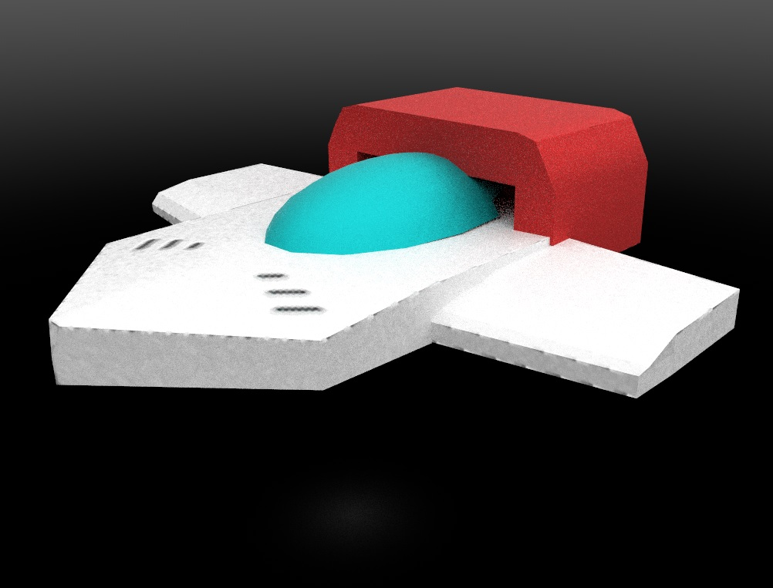
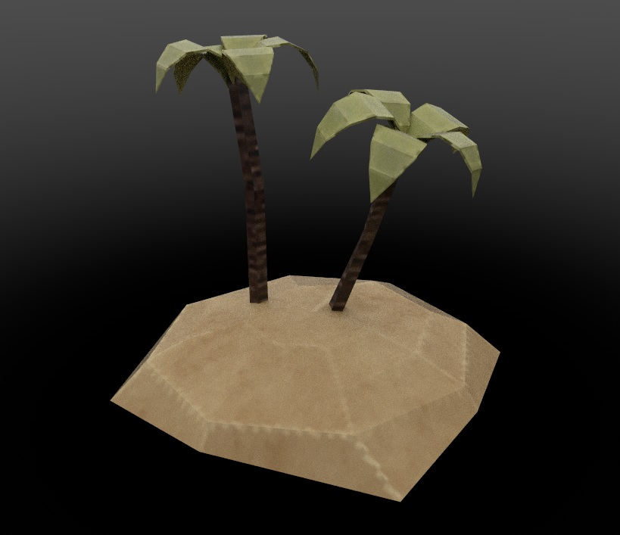
Concept and model

Slide 6
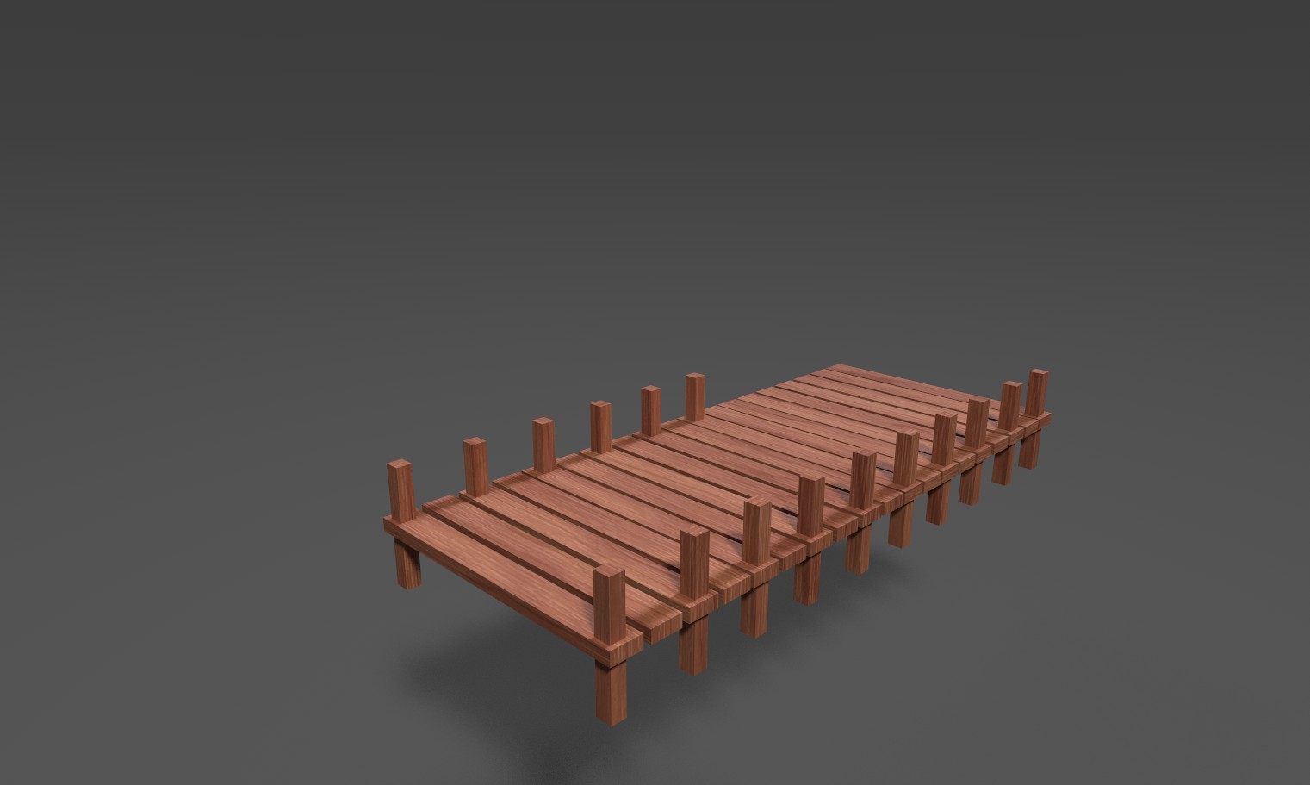
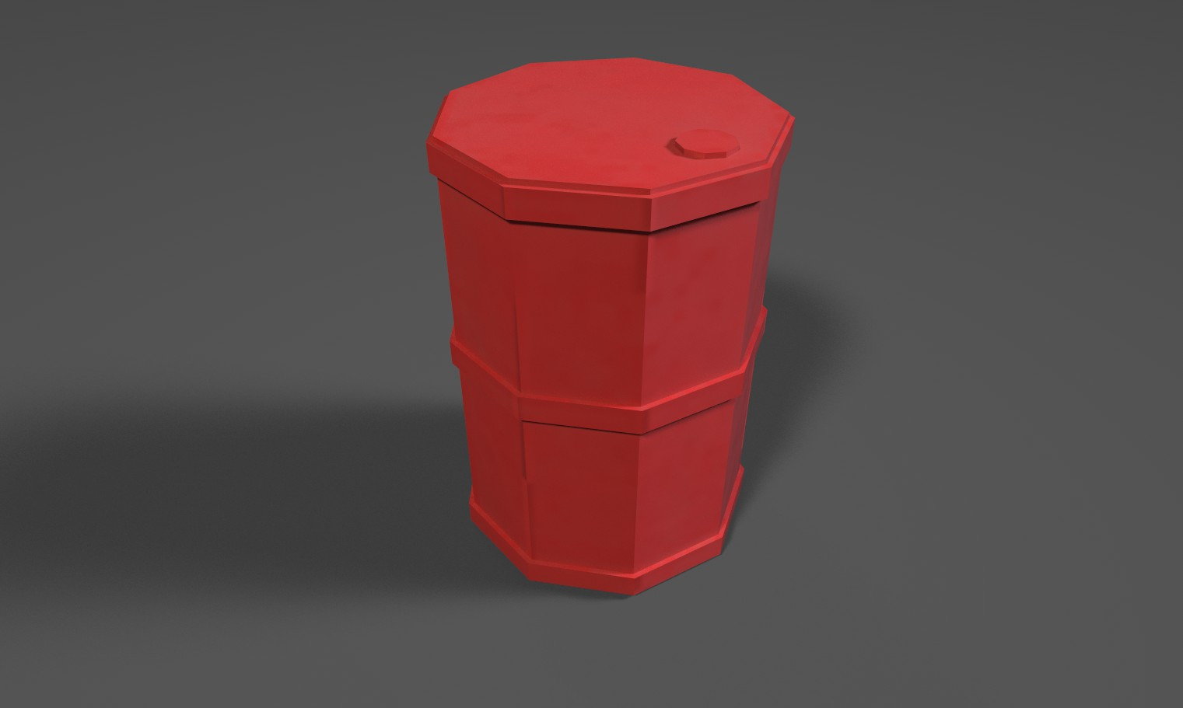
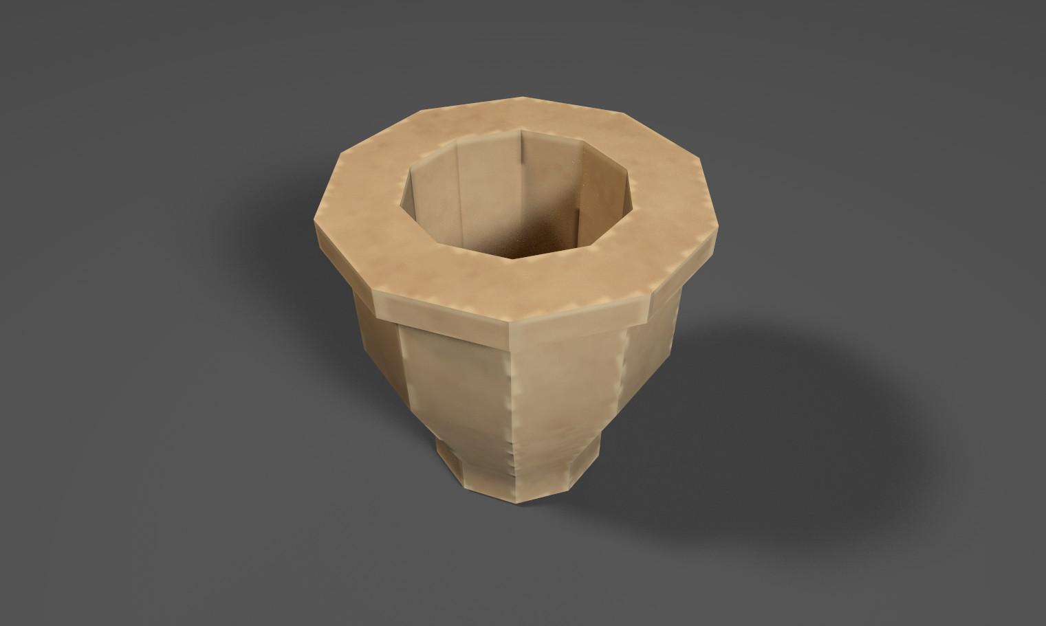
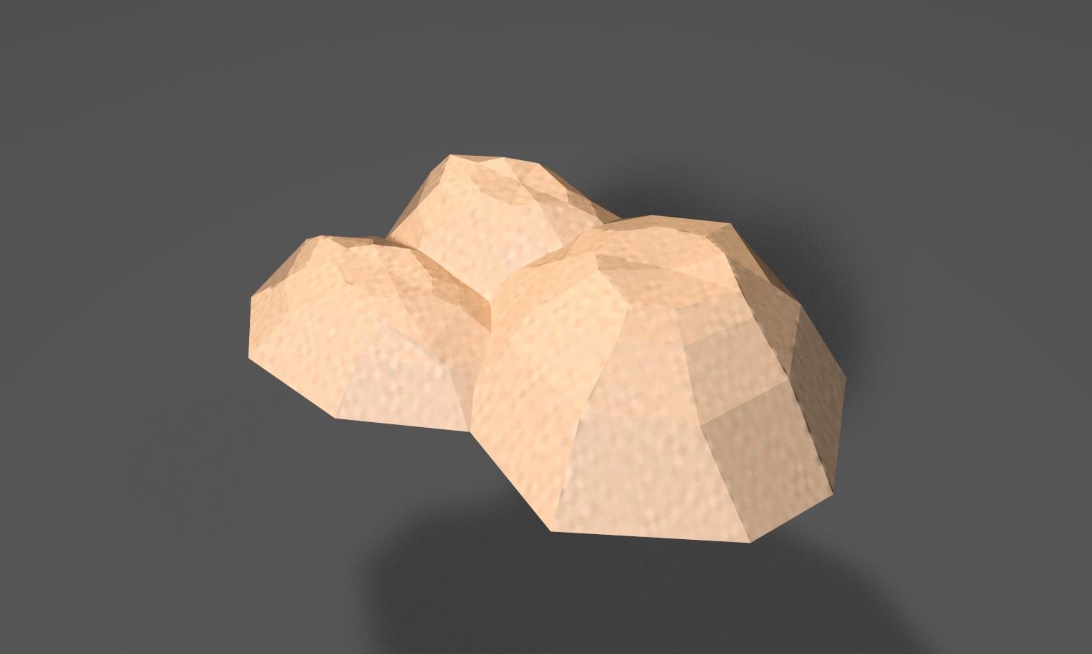
3D Assets

Slide 7
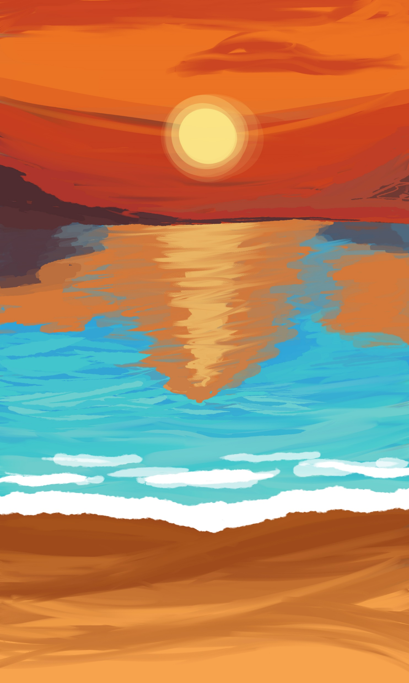



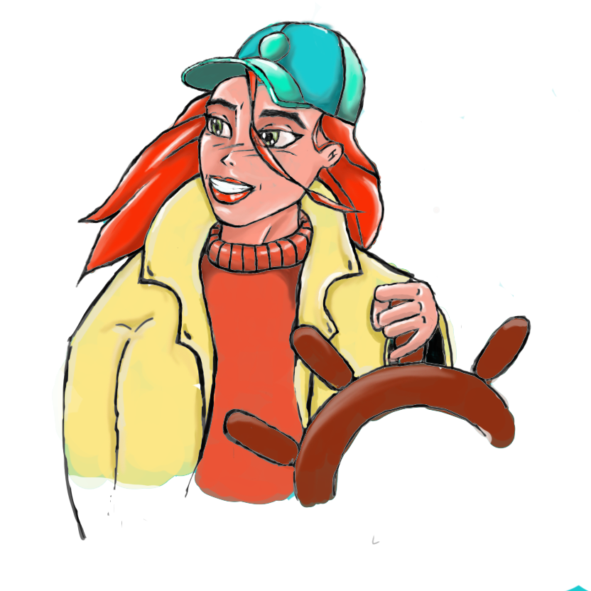












UI Assets

Slide 8

Music & sound effects
Crash
A different song per level
&
Over 20 different sound effects
Boat engine
Ocean

Slide 9
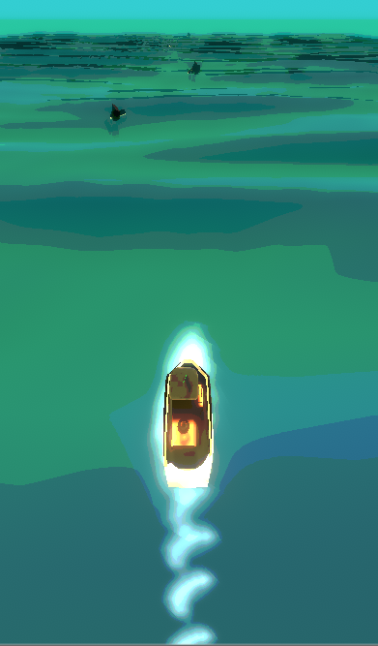
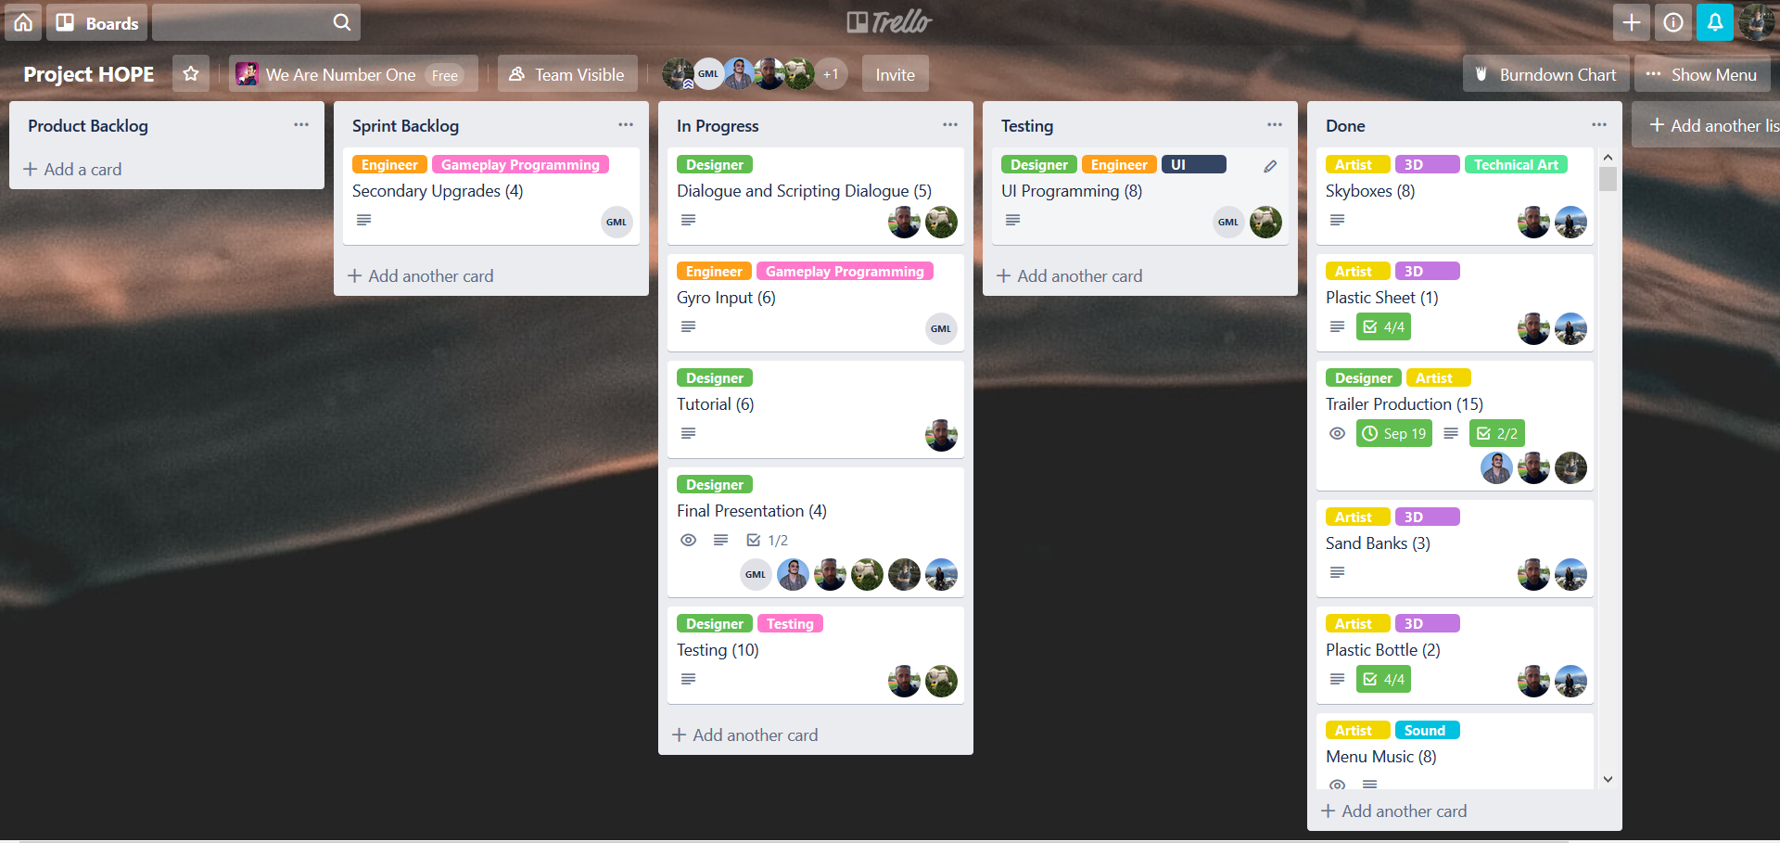
Rob Artist
Shaders
Particles
3D modeling
Project management

Slide 10
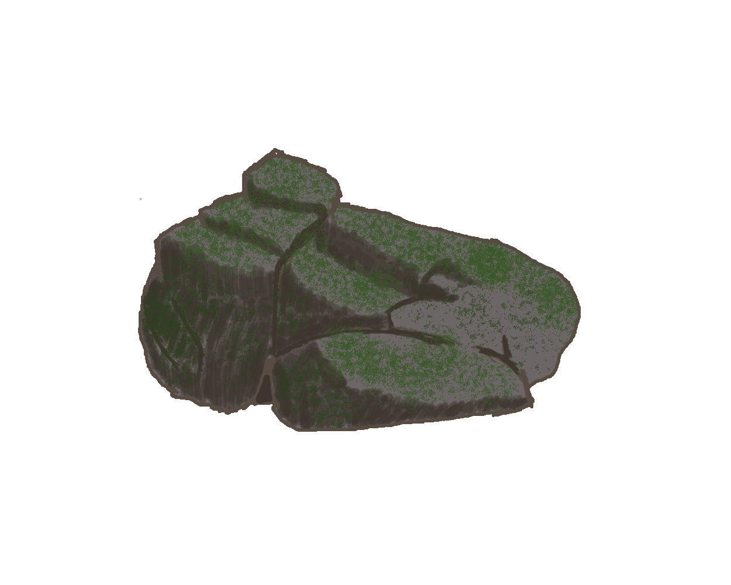
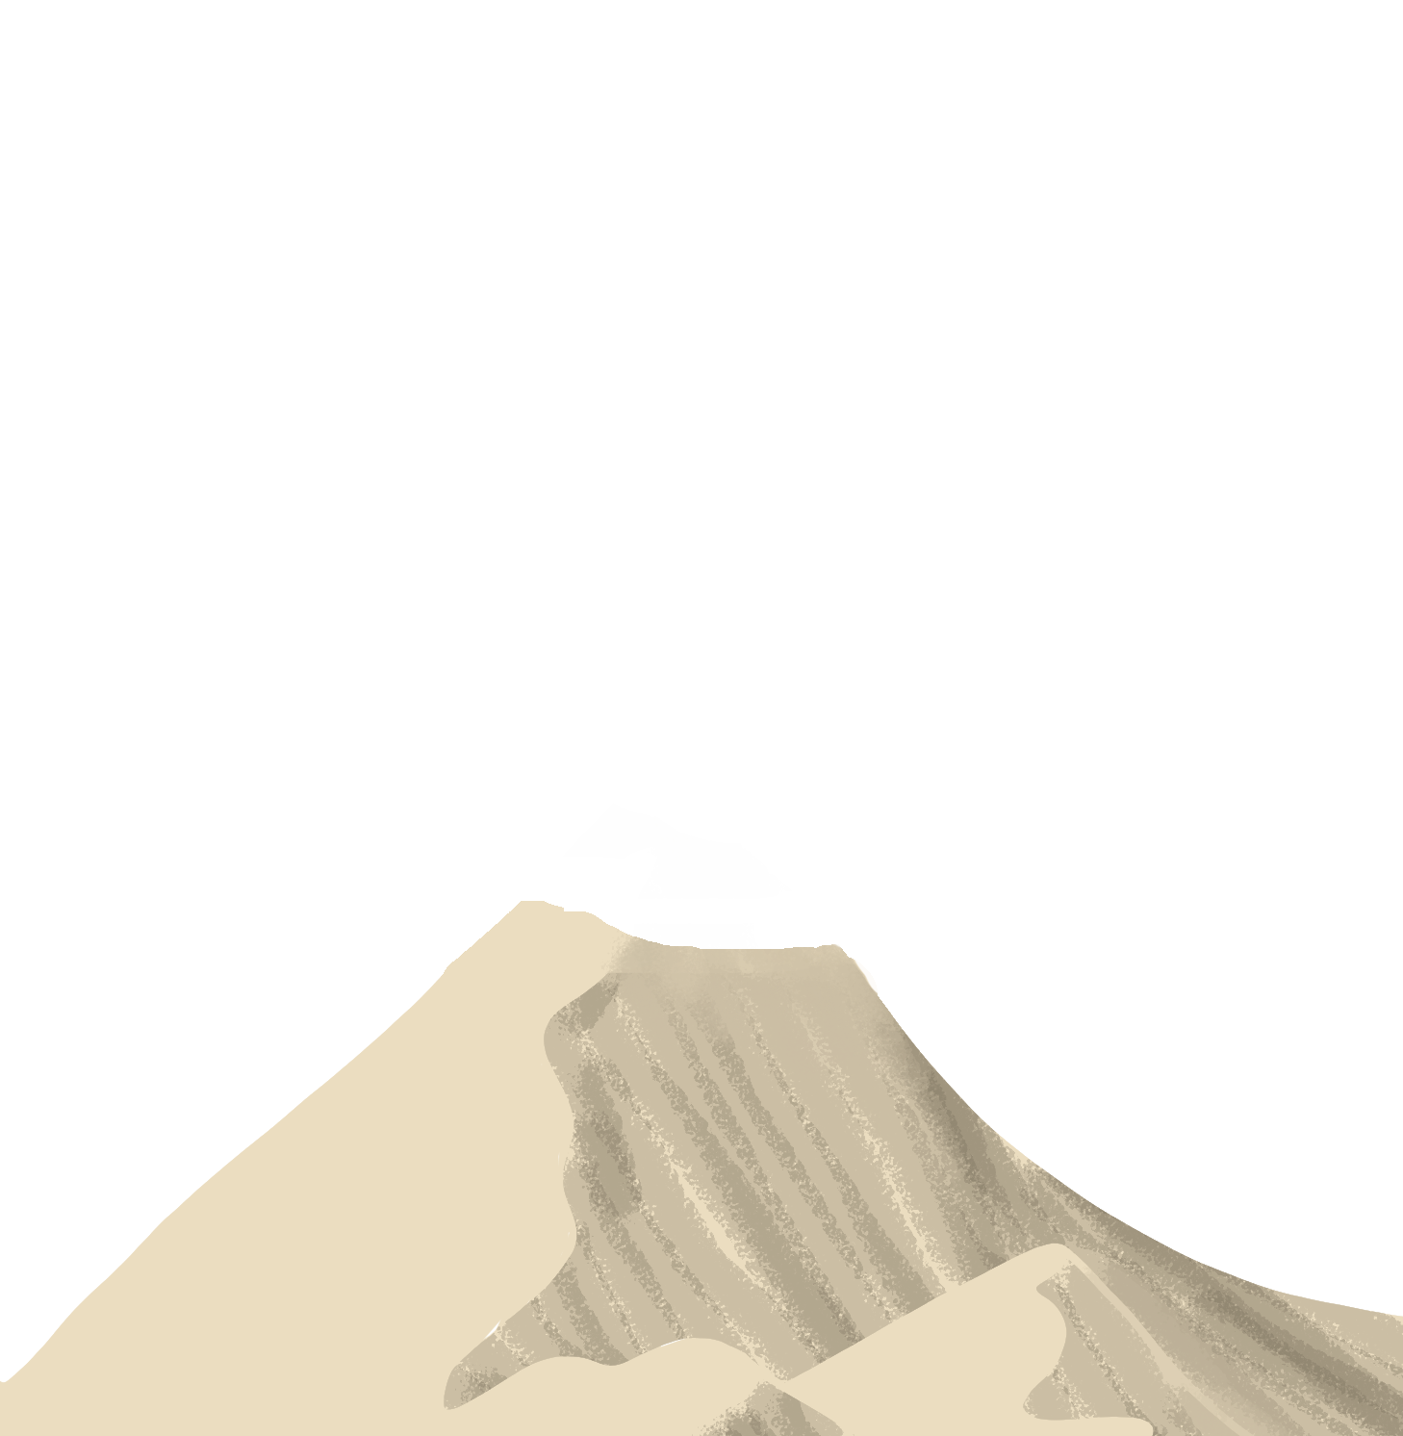

Humam Artist
Concept art
Audio sound effects
Music
UI animation

Slide 11


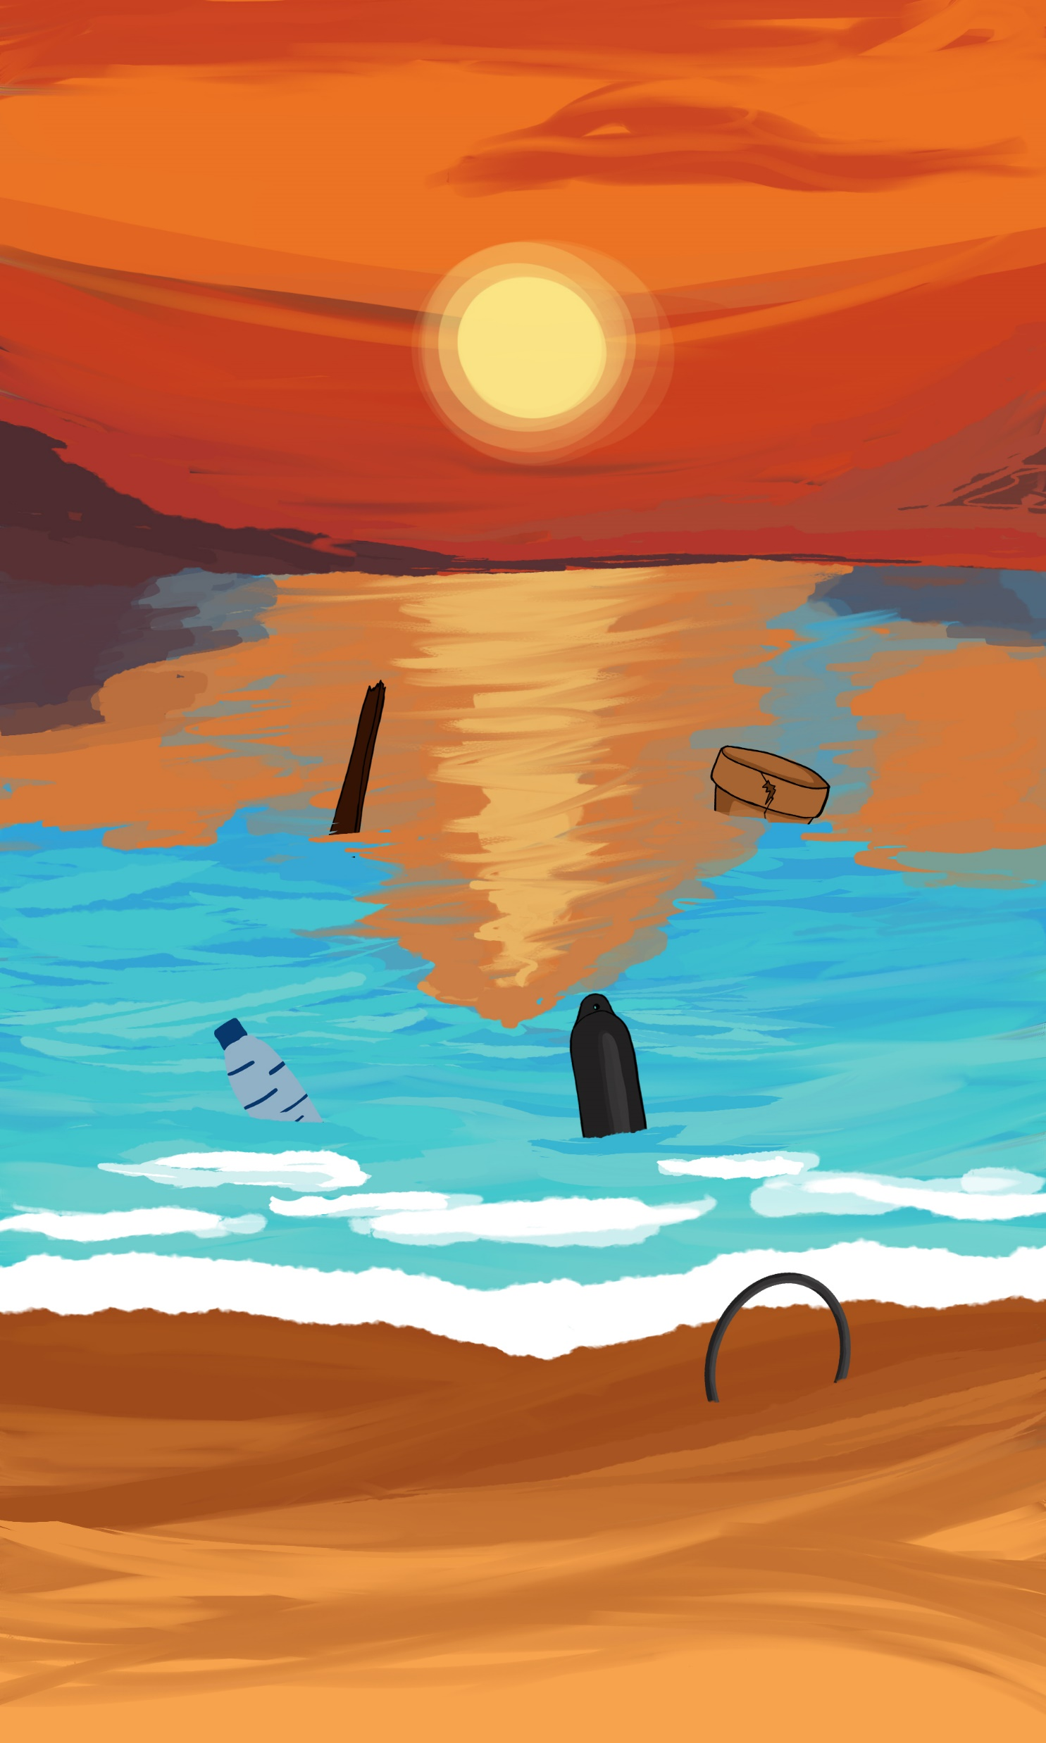

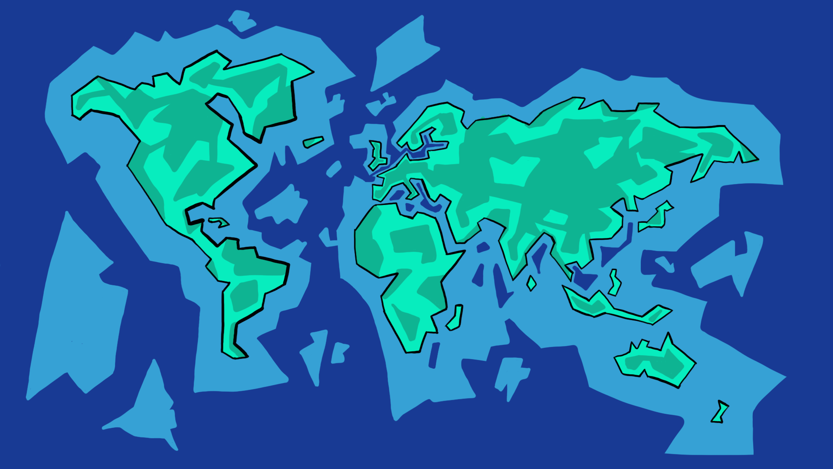
Tamara Artist
Concept art
UI art
UV-mapping and texturing
Skyboxes
Backgrounds start screen

Slide 12
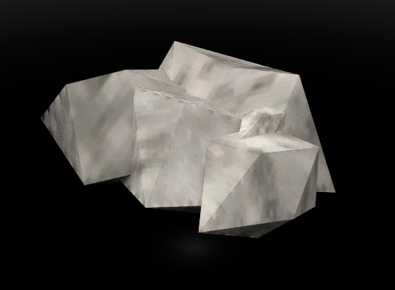
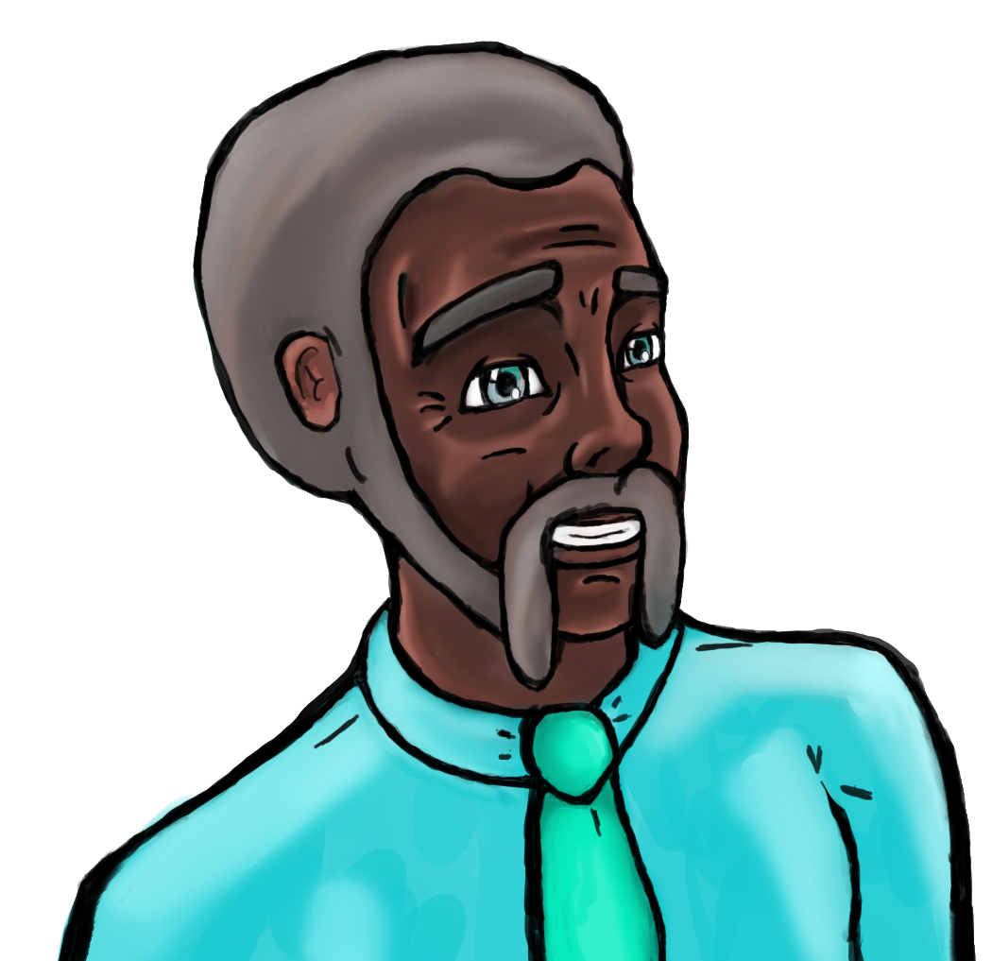
Olivier Designer/Artist
Concepting
3D models
Texturing
Character design
Dialog text

Slide 13

Rick Designer
Research
Game design documentation
UI design
UI programming
Audio programmer
Testing

Slide 14
Glyn Programmer
Tools
Gameplay

Slide 15
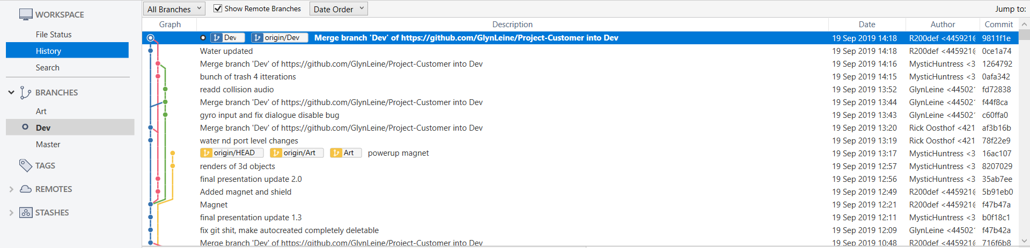
Team reflection
Communication
Git
Trello
What could we improve?
What went well?
Green card!

Slide 16
Thank you for listening!
Any questions?

